Slide 1
Grains and Rice
US, April 2016

Slide 2
The Issues
Modest pace of growth continues
Dry rice and oats are household staples, others have room to grow
Despite generally healthy image, opportunity for more specific education

Slide 3
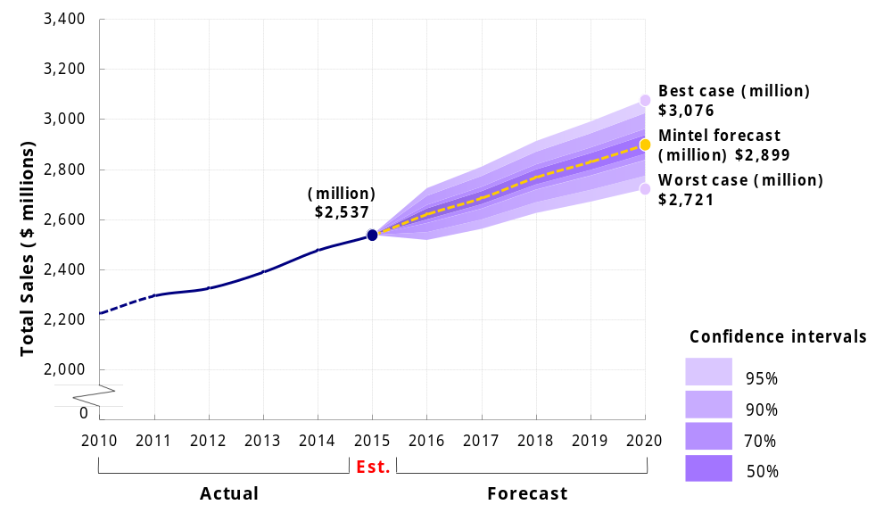
Moderate pace of growth continues
The rice and grains category has experienced modest growth in recent years, rising 14% between 2010 and 2015 to $2.5 billion. As consumers continue to embrace a wider variety of ethnic cuisines, sales of rice and grains in various forms and flavors are likely to continue on a positive course .
TOTAL US SALES AND FAN CHART FORECAST OF RICE AND GRAINS, AT CURRENT PRICES, 2010-20
Source: Based on Information Resources, Inc., InfoScan Reviews; U.S. Census Bureau, Economic Census; Progressive Grocer's Consumer Expenditure Study/Mintel

Slide 4
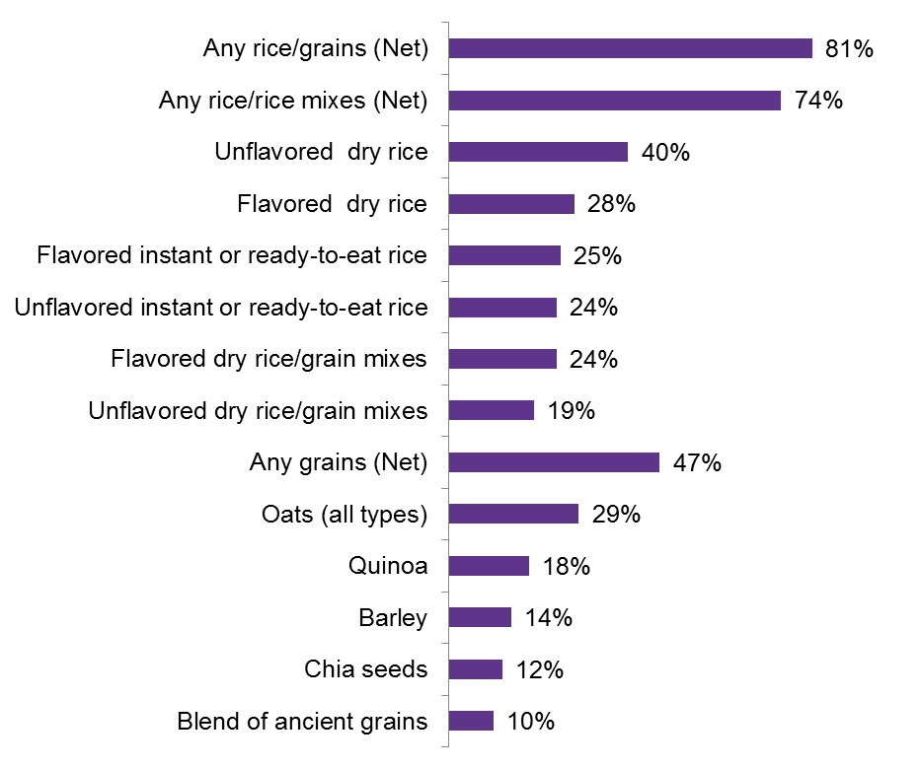
Dry rice and oats are household staples, others have room to grow
PURCHASE OF RICE AND GRAINS, JANUARY 2016
Rice and grains are staples in most households, with more than four out of five adults reporting purchasing any type of prepackaged rice or grain product in the past three months. Unflavored dry rice and oats, both of which are well-established and versatile, are the most commonly purchased. Other types of rice and grain products are purchased at lower rates but may represent growth opportunities for brands and retailers.
Source: Lightspeed GMI/Mintel; Base: 2,000 internet users aged 18+

Slide 5
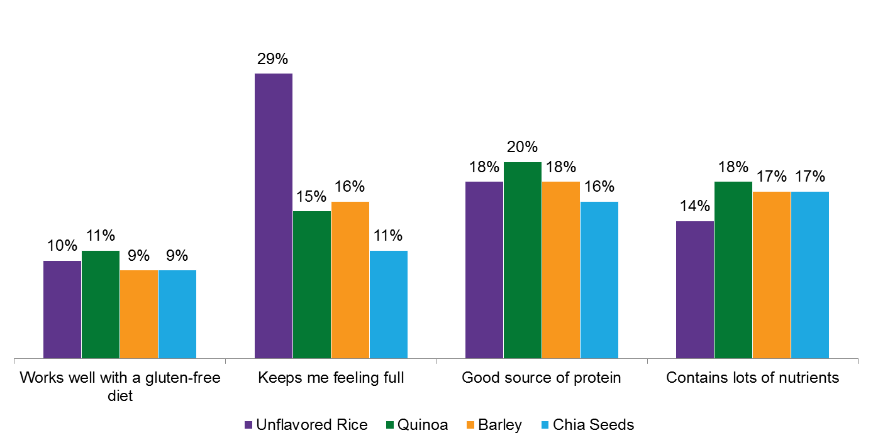
Despite generally healthy image, opportunity for more specific education
While rice and grains tend to get credit for being healthful, there appears to be ample room to educate consumers on specific health benefits. Relatively few consumers appear to have a strong understanding of the nutritional attributes of rice or various grain products.
HEALTH ATTRIBUTES ASSOCIATED WITH RICE AND GRAINS, JANUARY 2016
Source: Lightspeed GMI/Mintel; Base: 2,000 internet users aged 18+

Slide 6
The Opportunities
Not just dinner: snacking, lunch important occasions for young adults
Younger adults more likely to seek specific health benefits
Opportunity to pair rice and grains with a wide range of cuisines

Slide 7
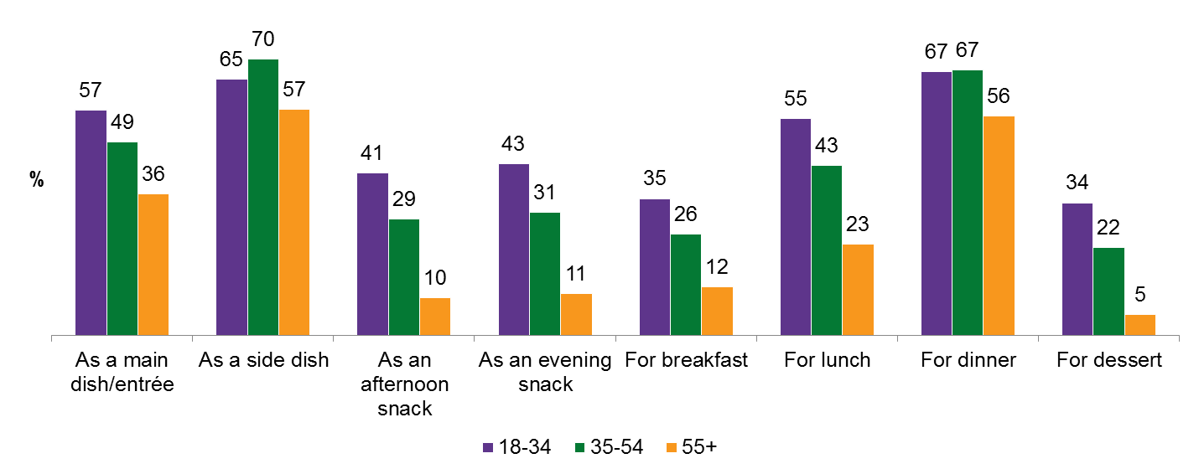
Not just dinner: snacking, lunch important occasions for young adults
While all age groups are likely to eat rice or grains as a side dish at dinner, adults aged 18-34, primarily Millennials, are considerably more likely than their older counterparts to include rice or grains at lunch and to eat them as an afternoon or evening snack. Millennials are substantially more likely than other generations to be frequent snackers and are more likely to be drawn to organic snacks and snacks with added nutrition. Rice and grain brands can play into Millennials’ strong interest in snacking with single-serve ready-to-eat products in a variety of flavors.
HOW AND WHEN RICE AND GRAINS ARE CONSUMED, BY AGE, JANUARY 2016
Source: Lightspeed GMI/Mintel; Base: 2,000 internet users aged 18+

Slide 8
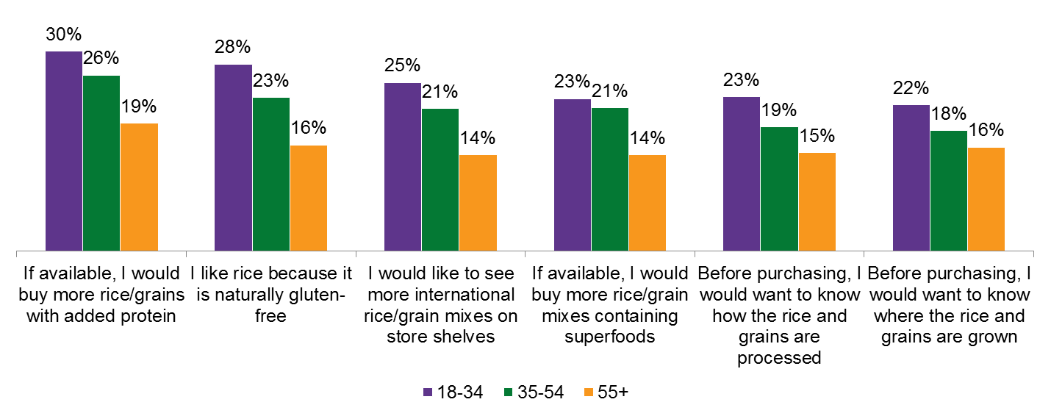
Younger adults more likely to seek specific health benefits
While the belief that rice and grains are healthier than pasta is prominent across age and other demographic measures, young adults place added emphasis on these values and are more likely to look for specific health and nutrition benefits when they shop for rice and grains. These findings highlight the opportunity for rice and grain retailers and brands to take an information-specific approach to marketing. Highlighting the specific health and nutrition benefits of different rice and grain products – as well as their appropriateness for different types of cuisines – can help to assure shoppers they are making the best choices for their own needs.
ATTITUDES TOWARD RICE AND GRAINS, BY AGE, JANUARY 2016
Source: Lightspeed GMI/Mintel; Base: 2,000 internet users aged 18+

Slide 9
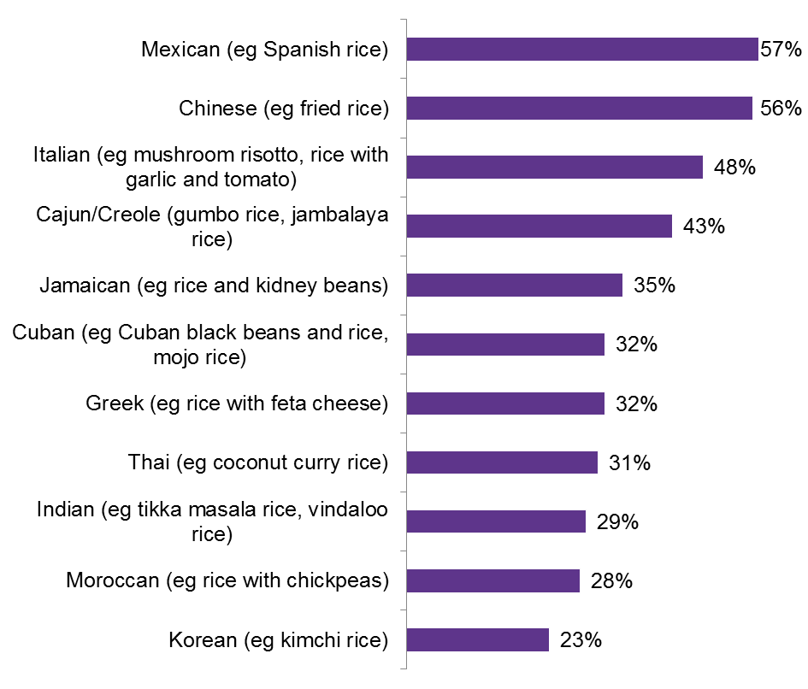
Opportunity to pair rice and grains with a wide range of cuisines
INTEREST IN FLAVORED RICE OR GRAIN MIXES, JANUARY 2016
Reflecting the culinary versatility of rice and grains, consumers express interest in purchasing a wide range of international flavored rice or grain mixes. Mexican, Chinese, and Italian varieties rank as the most popular varieties, consistent with the popularity of these cuisines for home meal preparation. A wide range of other global culinary-inspired varieties also attract significant interest, ranging from Cajun/Creole to Korean. For rice and grains brands and retailers, taking advantage of these diverse interests can take a variety of forms depending on the level of cooking confidence of the target consumer.
Source: Lightspeed GMI/Mintel; Base: 2,000 internet users aged 18+

Slide 10
What it Means
The rice and grains category is experiencing modest growth thanks in part to a generally healthy image and consumer interest in exploring an increasingly wide range of cuisines incorporating rice or grain.
Brands and retailers can build on these positives through marketing that highlights the specific nutrition benefits of different rice and grain varieties as well as new serving ideas and recipes.
In addition, new convenience-oriented products and packaging could help to expand usage further into lunchtime and snacking occasions.

Slide 11

John Owen
Senior Food Analyst
info@mintel.com
mintel.com

